Slide 1
Instruction ExecutionCycle

Slide 2
A program residing in the memory unit of the computer consists of a sequence of instructions.
The program is executed in the computer by going through a cycle for each instruction.
The processing required for a single instruction is called an instruction cycle.
In the basic computer each instruction cycle consists of the following phases:
1. Fetch an instruction from memory.
2. Decode the instruction.
3. Read the effective address from memory if the instruction has an indirect
address.
4. Execute the instruction.
Upon the completion of step 4, the control goes back to step 1 to fetch, decode,
and execute the next instruction. This process continues indefinitely unless a
HALT instruction is encountered.

Slide 3
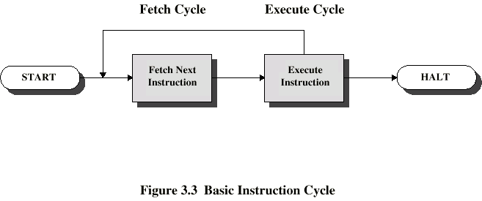
Basic Instruction Cycle

Slide 4
Fetch Cycle
Program Counter (PC) holds address of next instruction to fetch
Processor fetches instruction from memory location pointed to by PC
Increment PC
Instruction loaded into Instruction Register (IR)
Processor interprets instruction and performs required actions
Execute Cycle:
Processor-memory
data transfer between CPU and main memory
Processor I/O
Data transfer between CPU and I/O module
Data processing
Some arithmetic or logical operation on data
Control
Alteration of sequence of operations
e.g. jump

Slide 5
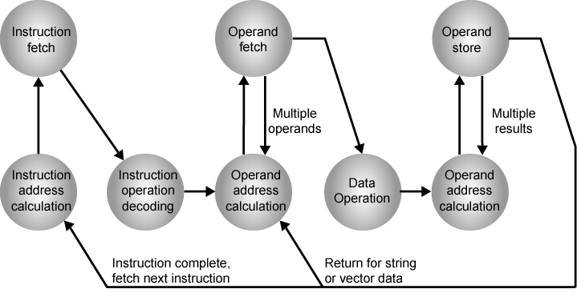
Instruction Cycle State Diagram

Slide 6
Instruction address calculation (iac): Determine the address of the next instruction to be executed. Usually, this involves adding a fixed number to the address of the previous instruction. For example, if each instruction is 16 bits long and memory is organized into 16-bit words, then add 1 to the previous address.
■ Instruction fetch (if): Read instruction from its memory location into the processor.
■ Instruction operation decoding (iod): Analyze instruction to determine type of operation to be performed and operand(s) to be used.
■ Operand address calculation (oac): If the operation involves reference to an operand in memory or available via I/O, then determine the address of the operand.
■ Operand fetch (of): Fetch the operand from memory or read it in from I/O.
■ Data operation (do): Perform the operation indicated in the instruction.
■ Operand store (os): Write the result into memory or out to I/O.
The diagram allows for multiple operands and multiple results, because some instructions on some machines require this. For example, the PDP-11 instruction ADD A,B results in the following sequence of states: iac, if, iod, oac, of, oac, of, do, oac, os.

Slide 7
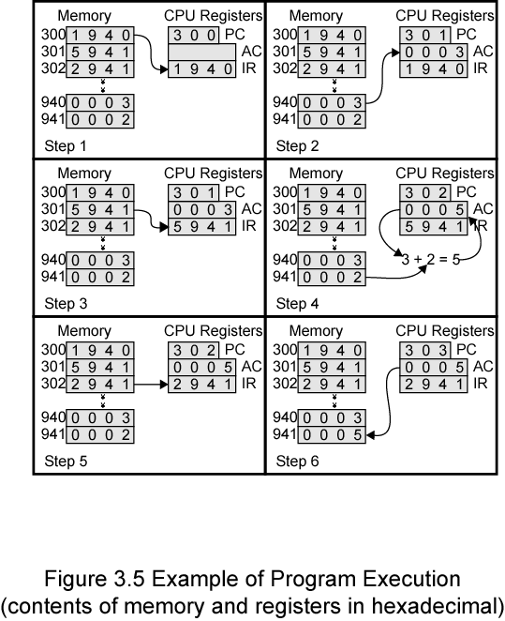
Example of Program Execution

Slide 8
Fetch And Decode
The microoperations for the fetch and decode phases can be specified by the
following register transfer statements.
T0: AR <- PC
T1: IR <-M[AR], PC <- PC + 1
T2: D0, • • • , D7 <- Decode IR(12-14), AR <--- IR(0-11), I <--- IR(15)
T1: IR <-M[AR], PC <- PC + 1

